Slide 1


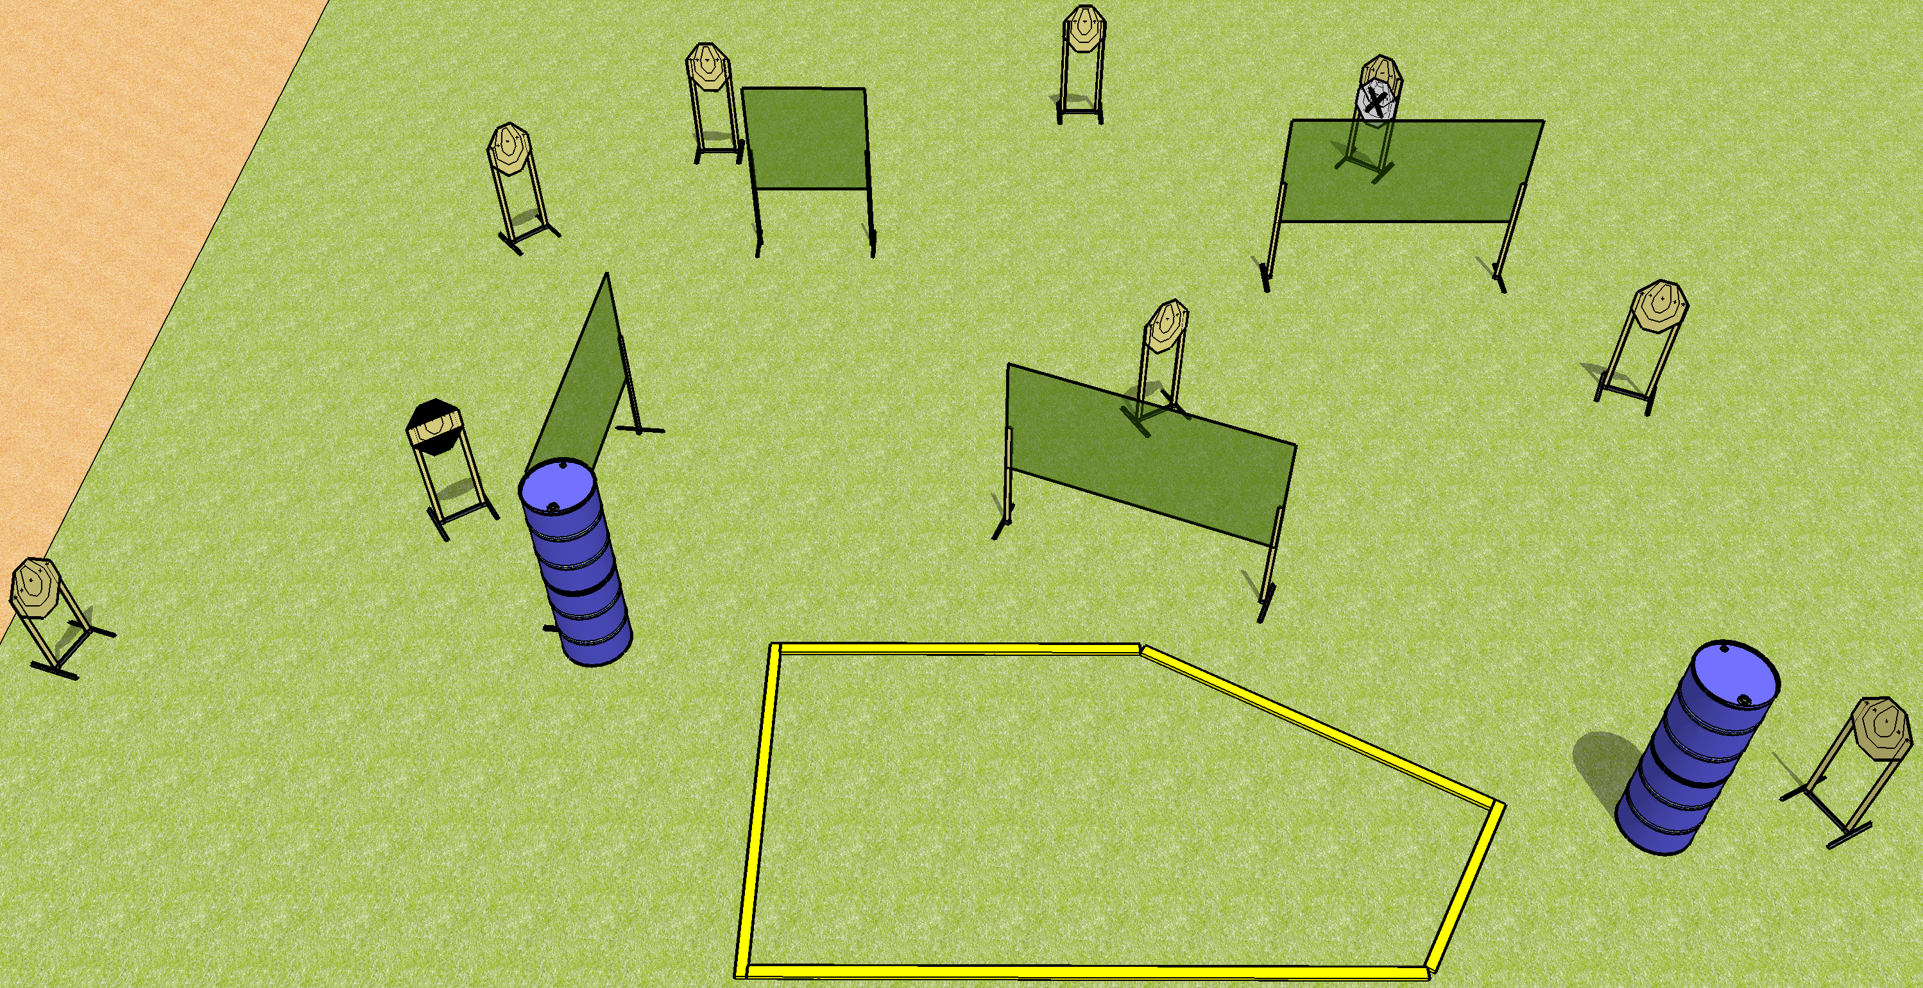
 | Dothan Gun Club – USPSA Match Off Like a Herd of Turtles Course Designer : Drew Coleman
Round Count 18 rounds 9 IPSC
Equipment List 8 wall feet 1 medium fault line 1 striped HC

Slide 2
Off Like a Herd of Turtles
Written Stage Briefing
Off Like a Herd of Turtles is an 18 round, 90 point, Comstock course of fire. There are 9 IPSC targets. The best 2 hits on paper will score. The start signal is audible.
Handgun start position is anywhere inside the shooting area, wrists below belt. Handgun is loaded and holstered.
PCC start position is anywhere inside the shooting area, stock on belt. Carbine is loaded, safety on.
On start signal, engage targets as they become available from within the shooting area.

